Slide 1

Notes:
Source order: cover.

Slide 2

Notes:
Source order: 54, Section 1.1.1, D2-D3.

Slide 3
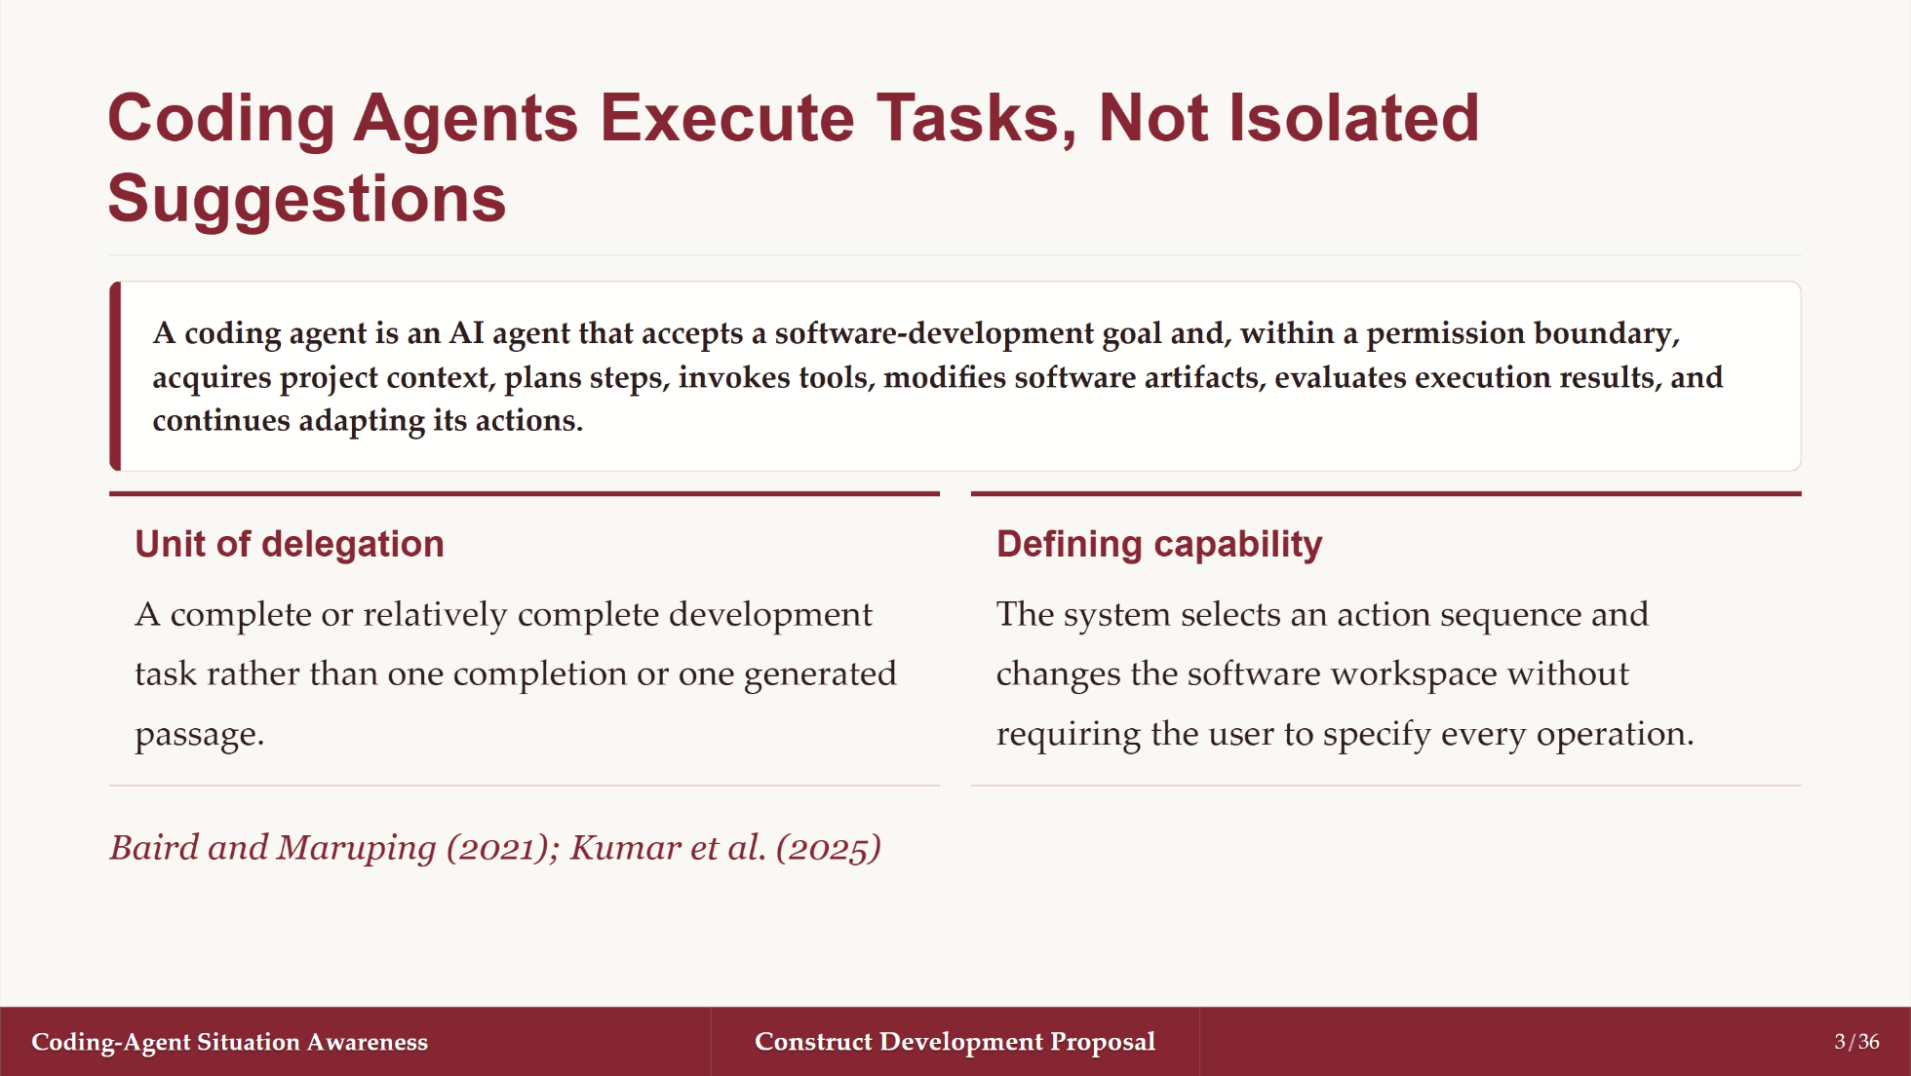
Notes:
Source order: 54, Section 1.1.1, D3 and D6.

Slide 4

Notes:
Source order: 54, Section 1.1.1, D4-D7.

Slide 5
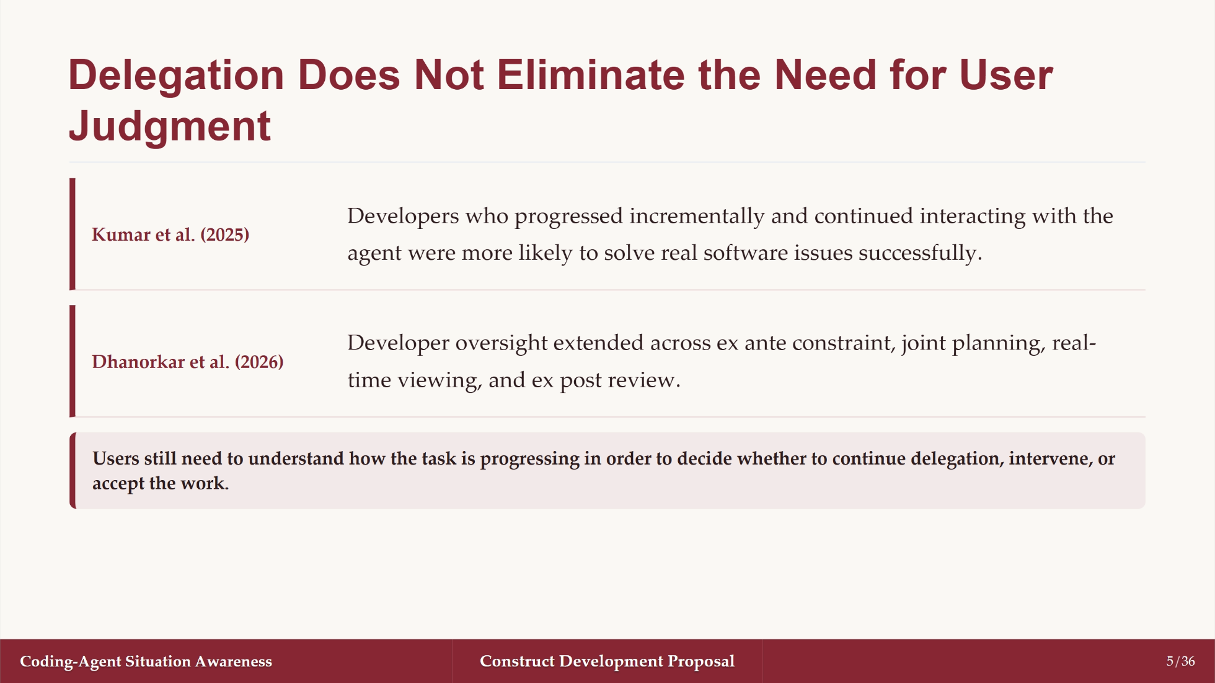
Notes:
Source order: 54, Section 1.1.1, D5.

Slide 6
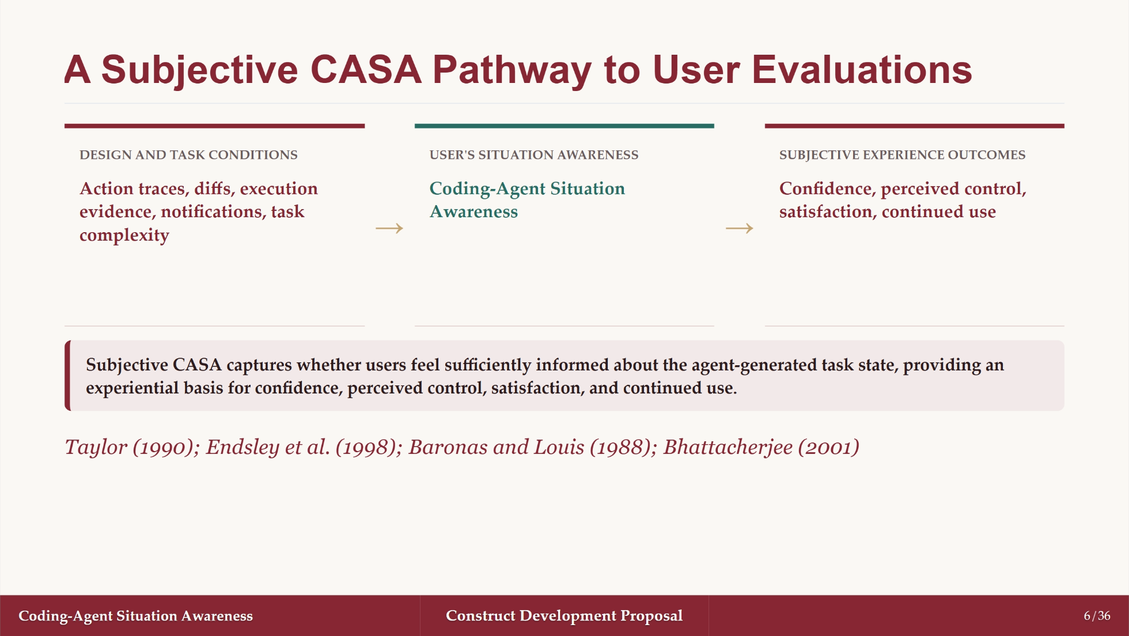
Notes:
Source order: 54, Section 1.1.1, D8. This concludes the background before problem formulation.

Slide 7
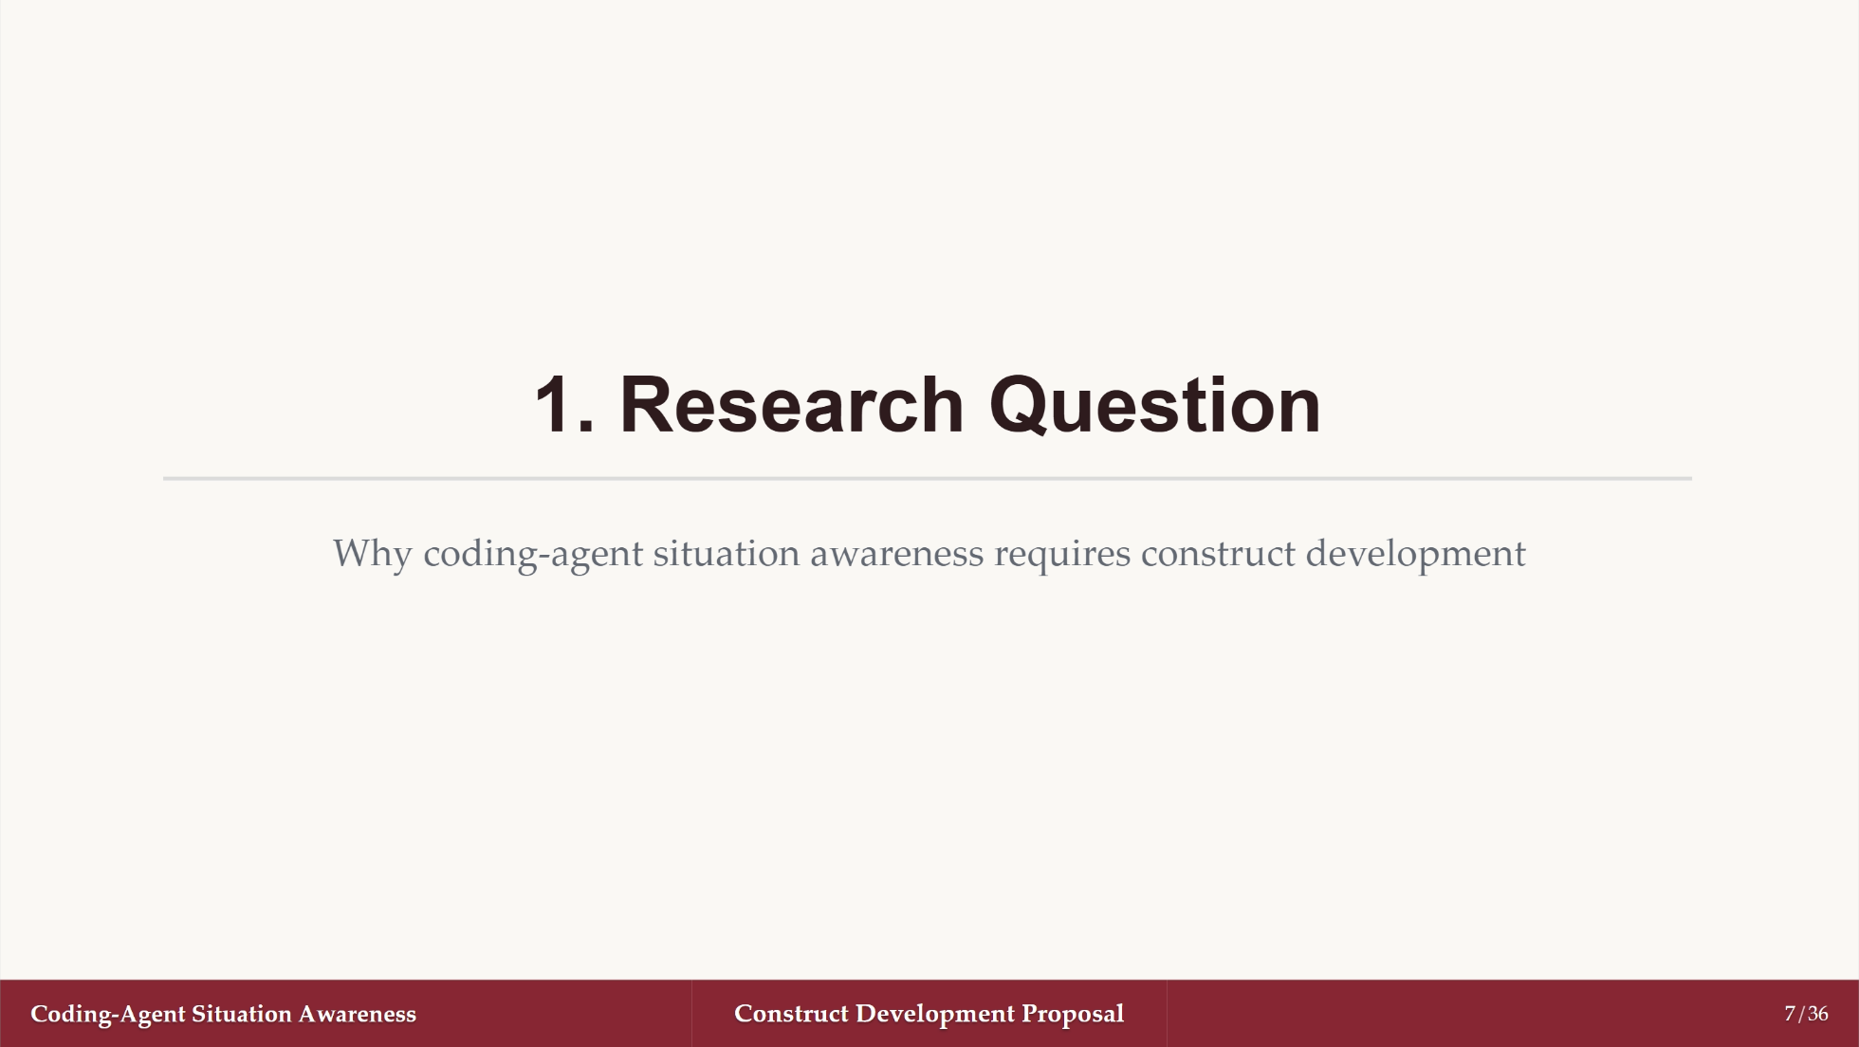
Notes:
Source order: 68, Section 1, begins here.

Slide 8
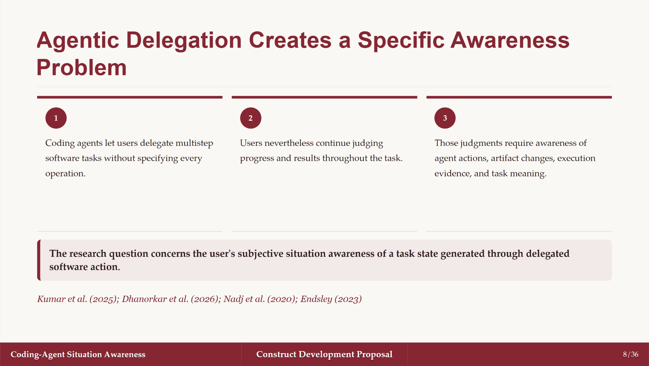
Notes:
Source order: 68, C19.1-C19.17.

Slide 9
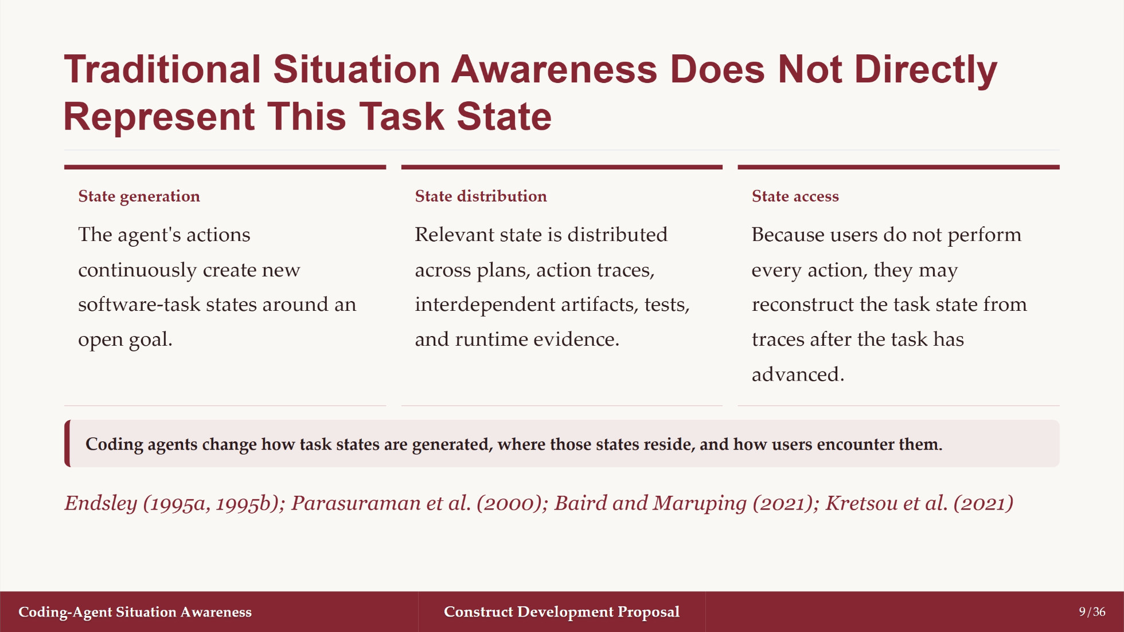
Notes:
Source order: 68, C21.1-C21.7.

Slide 10
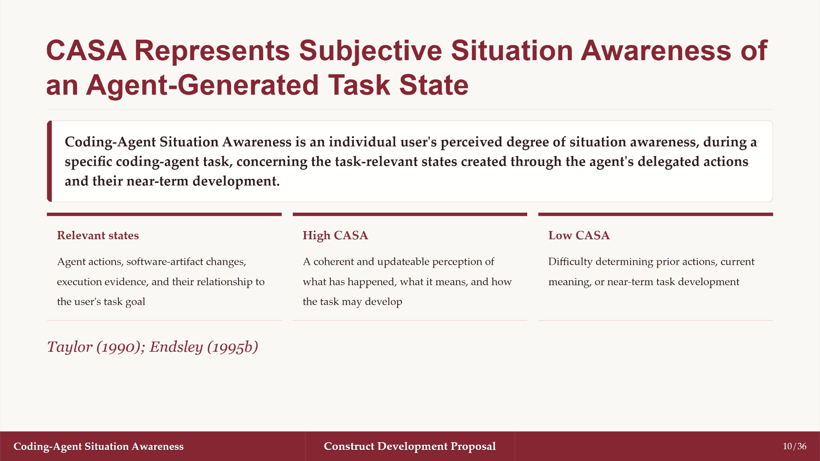
Notes:
Source order: 68, C23.1-C23.6.

Slide 11
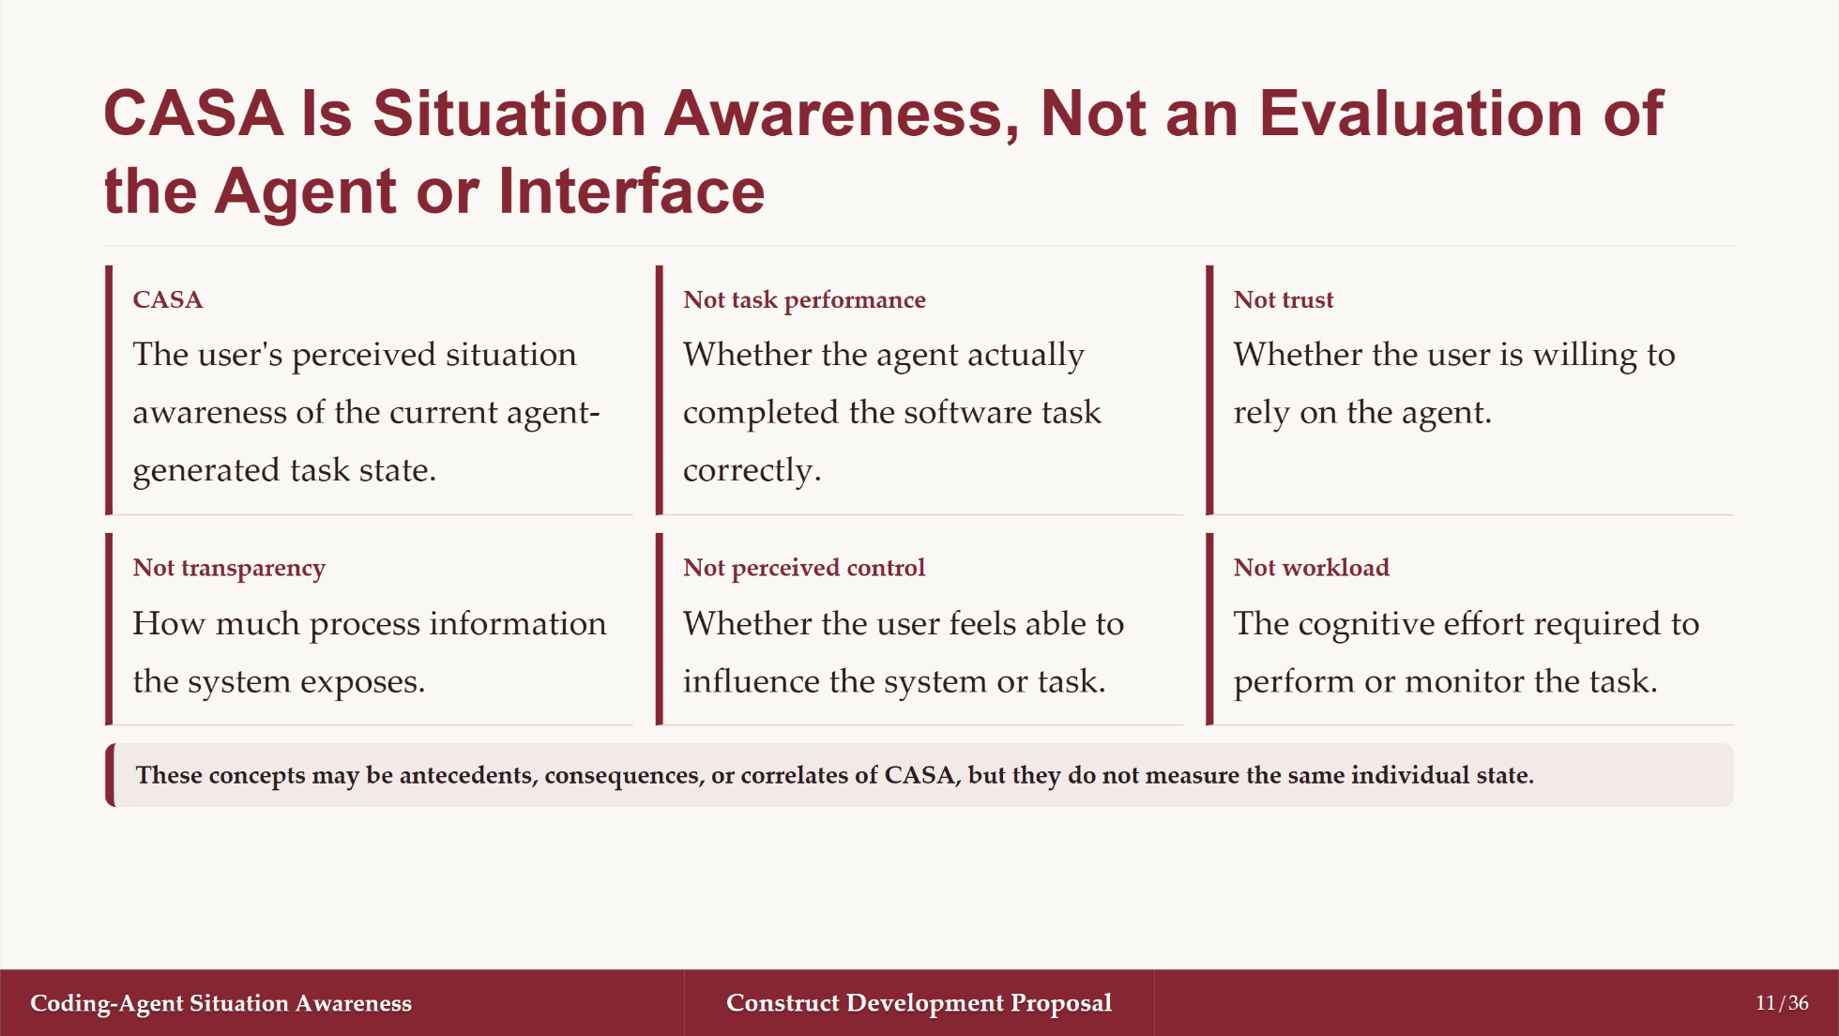
Notes:
Source order: 68, C23.7-C23.11 and construct boundaries.

Slide 12
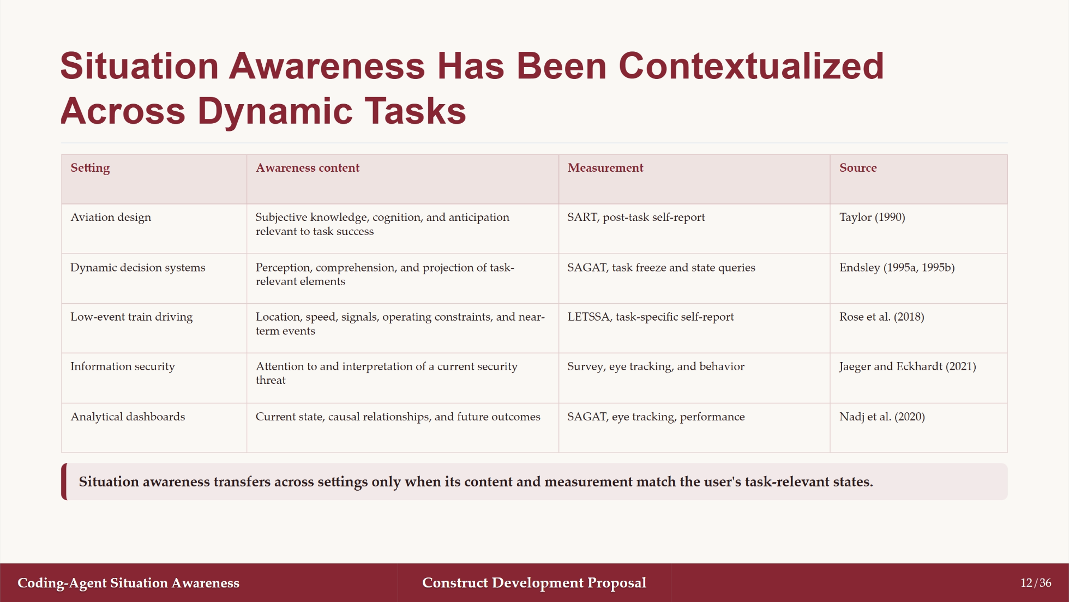
Notes:
Source order: 68, C25 and Table 1; first half.

Slide 13
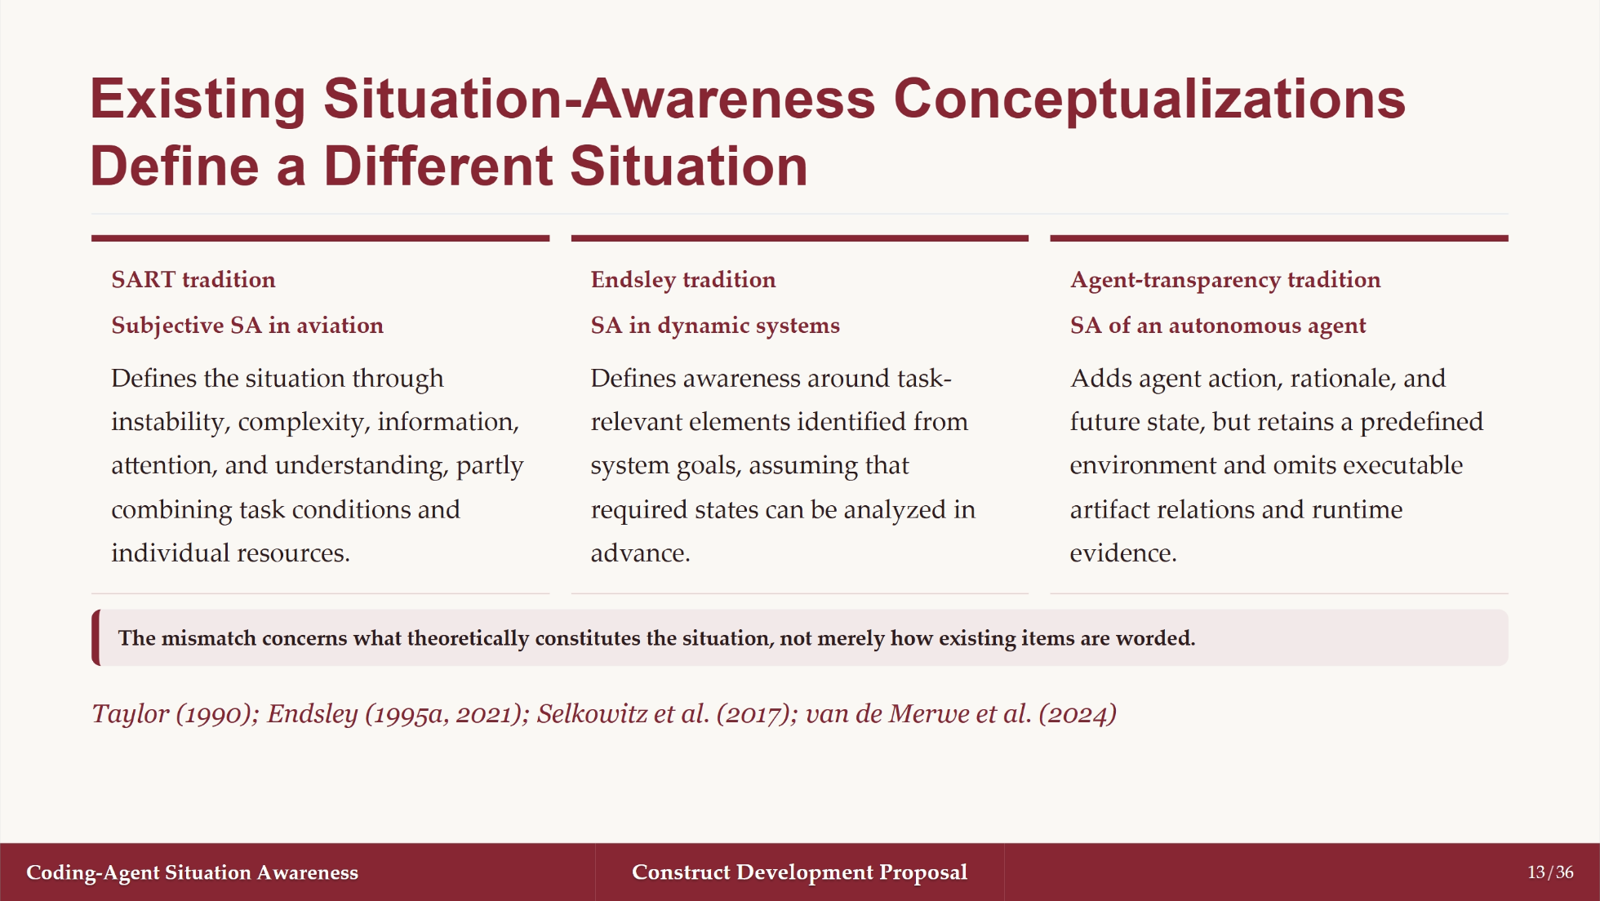
Notes:
Source order: 68, C27 and C47.

Slide 14
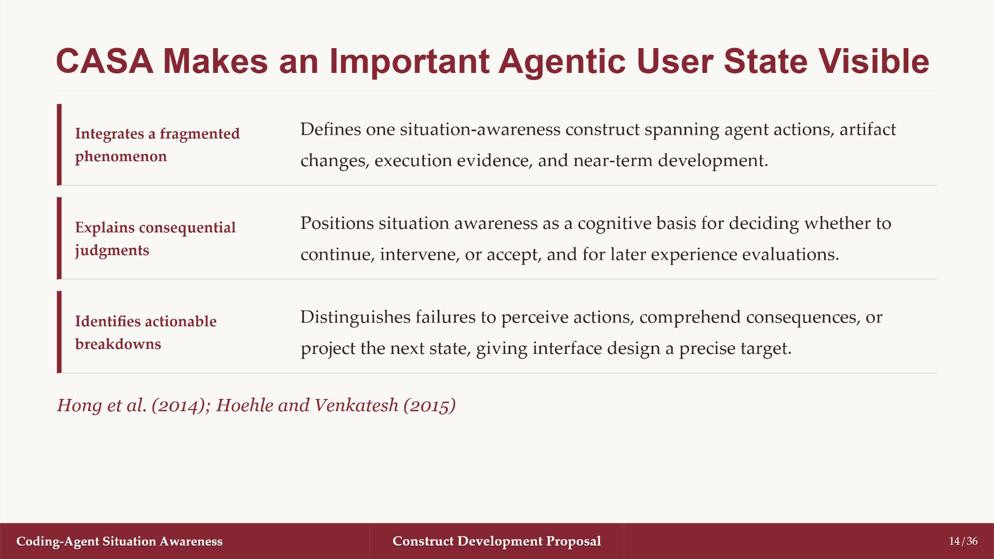
Notes:
Source order: 68, C29.1-C29.5.

Slide 15
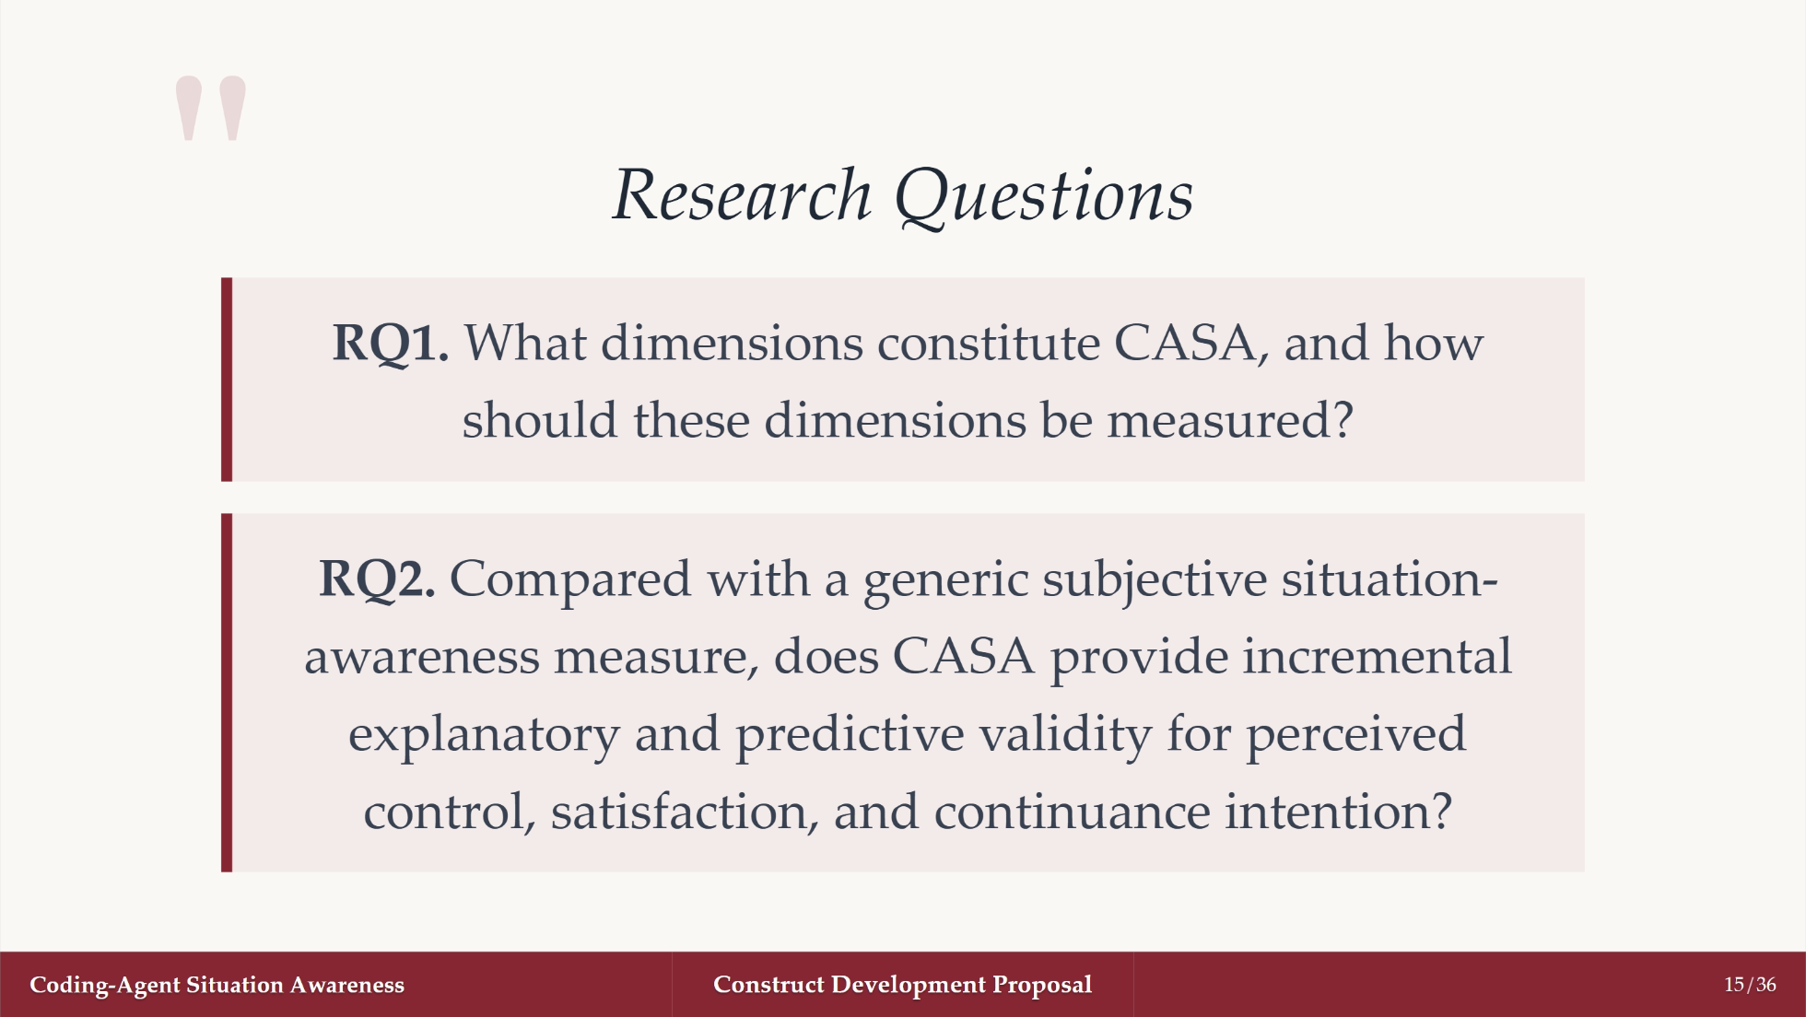
Notes:
Source order: 68, C31.1-C31.3.

Slide 16
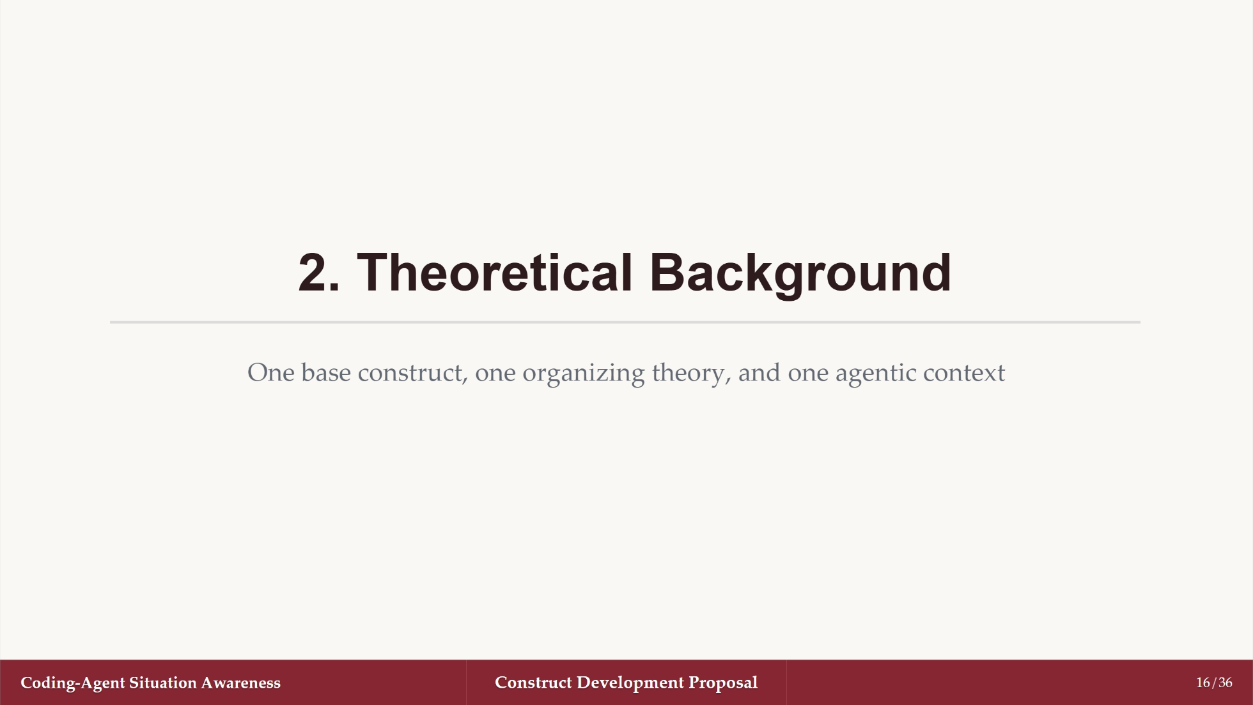
Notes:
Source order: 68, Section 2.

Slide 17
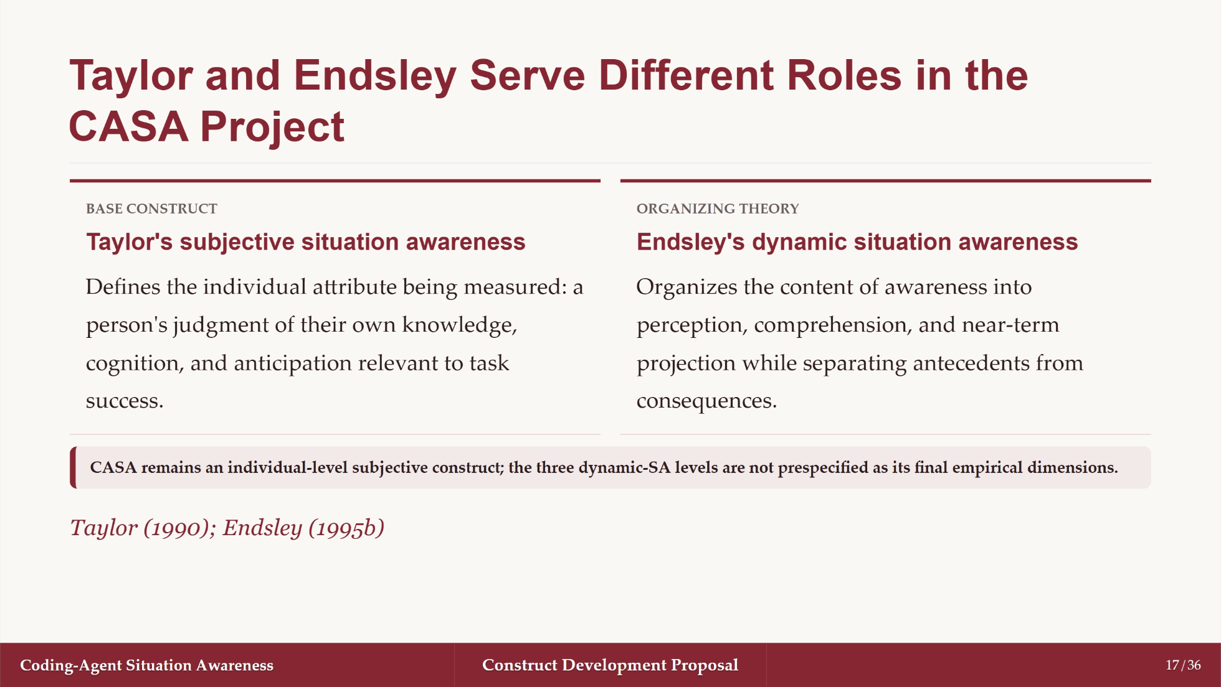
Notes:
Source order: 68, C45.1-C45.7.

Slide 18
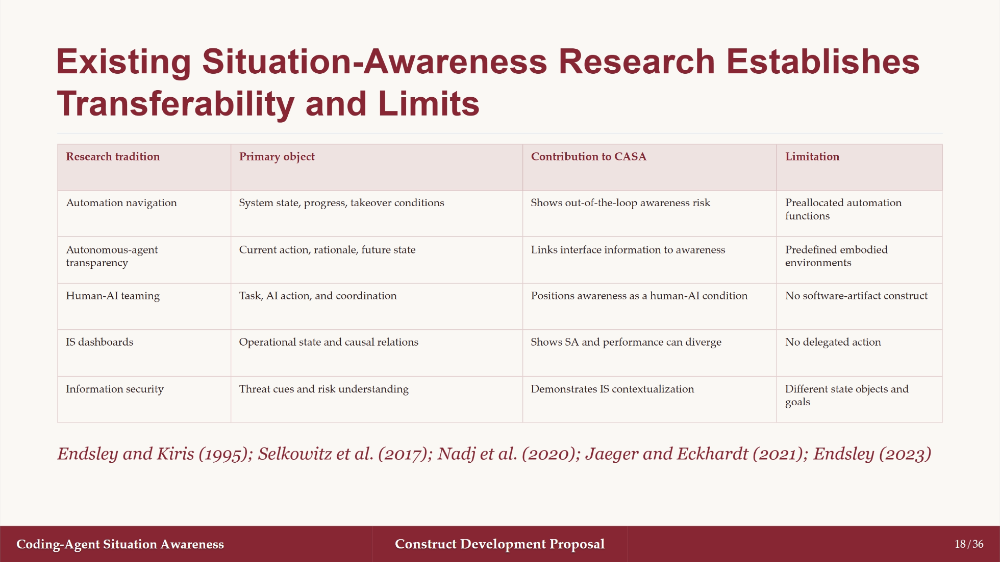
Notes:
Source order: 68, Table 1 and C47.

Slide 19
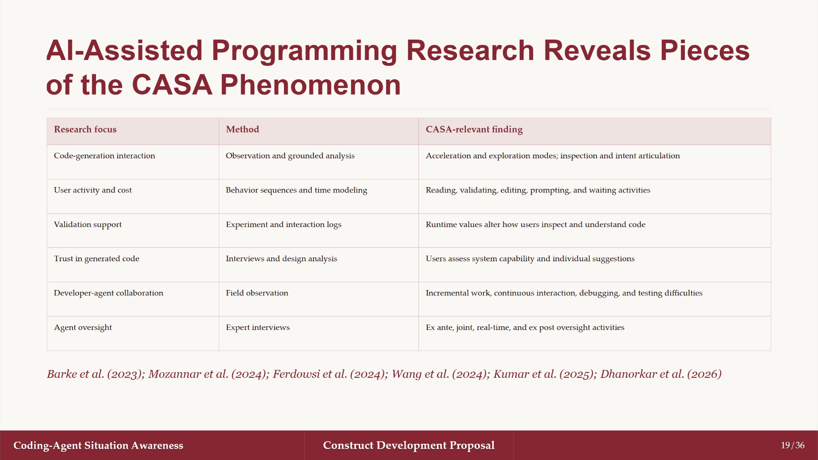
Notes:
Source order: 68, C51 and Table 2.

Slide 20
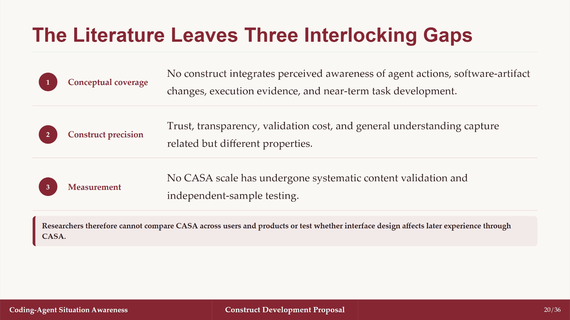
Notes:
Source order: 68, C53-C55.

Slide 21
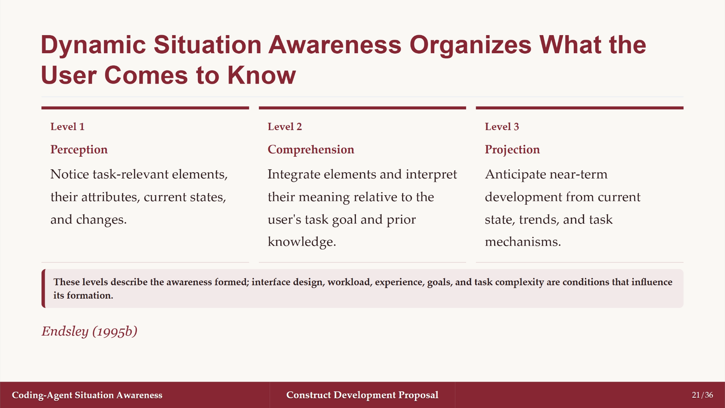
Notes:
Source order: 68, C59 and Table 3.

Slide 22
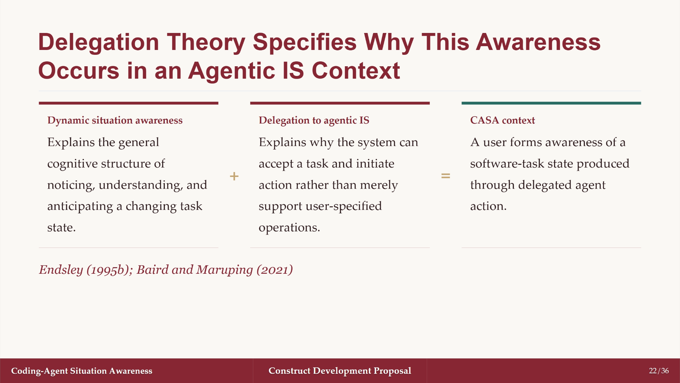
Notes:
Source order: 68, C61-C63.4.

Slide 23
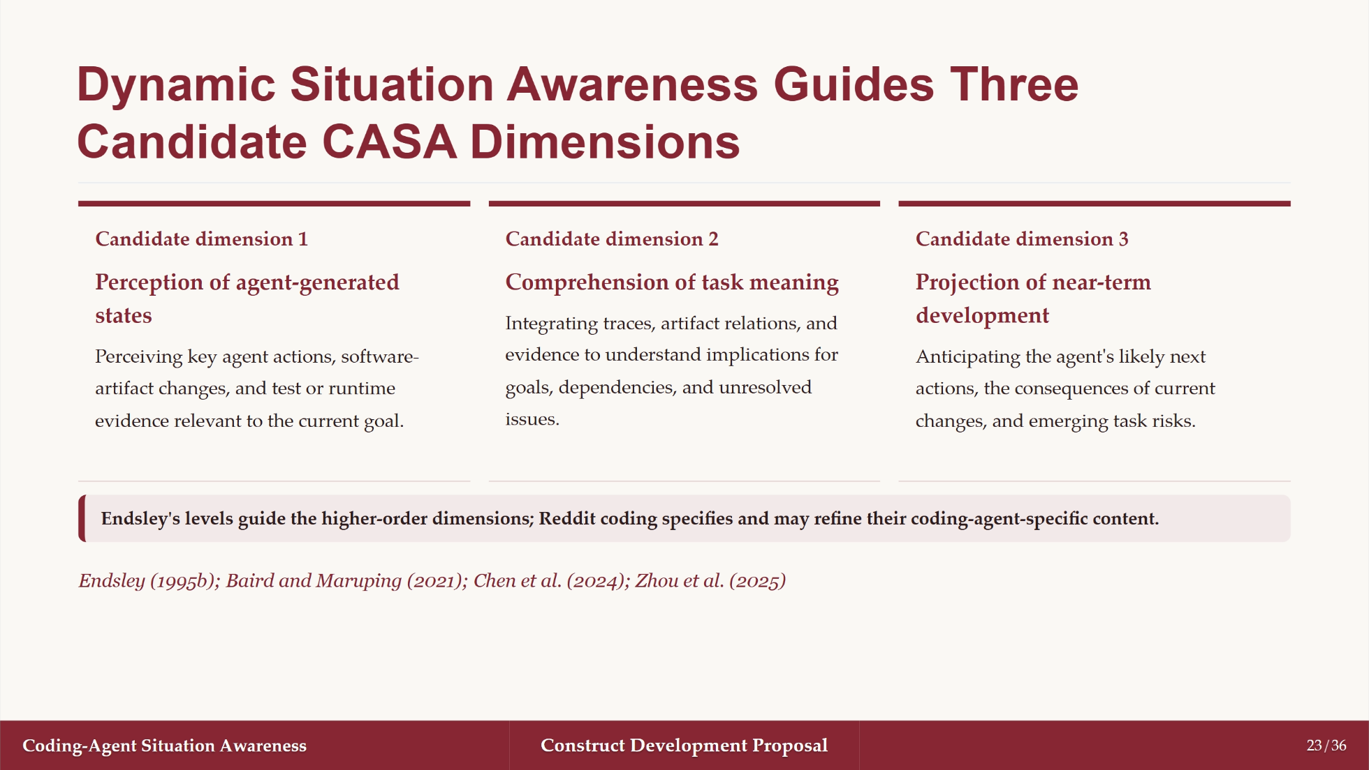
Notes:
Source order: 68, C63.5-C63.11.

Slide 24

Notes:
Source order: 68, Section 3.

Slide 25
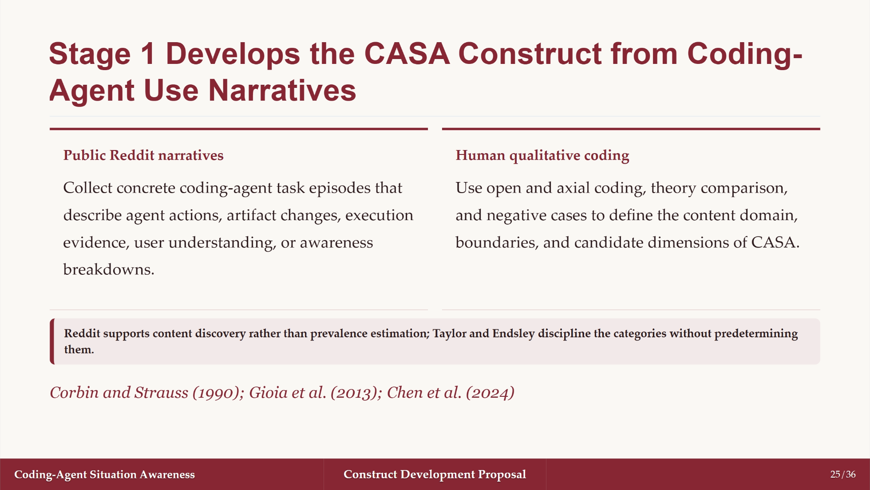
Notes:
Source order: 68, Sections 3-4, condensed.

Slide 26
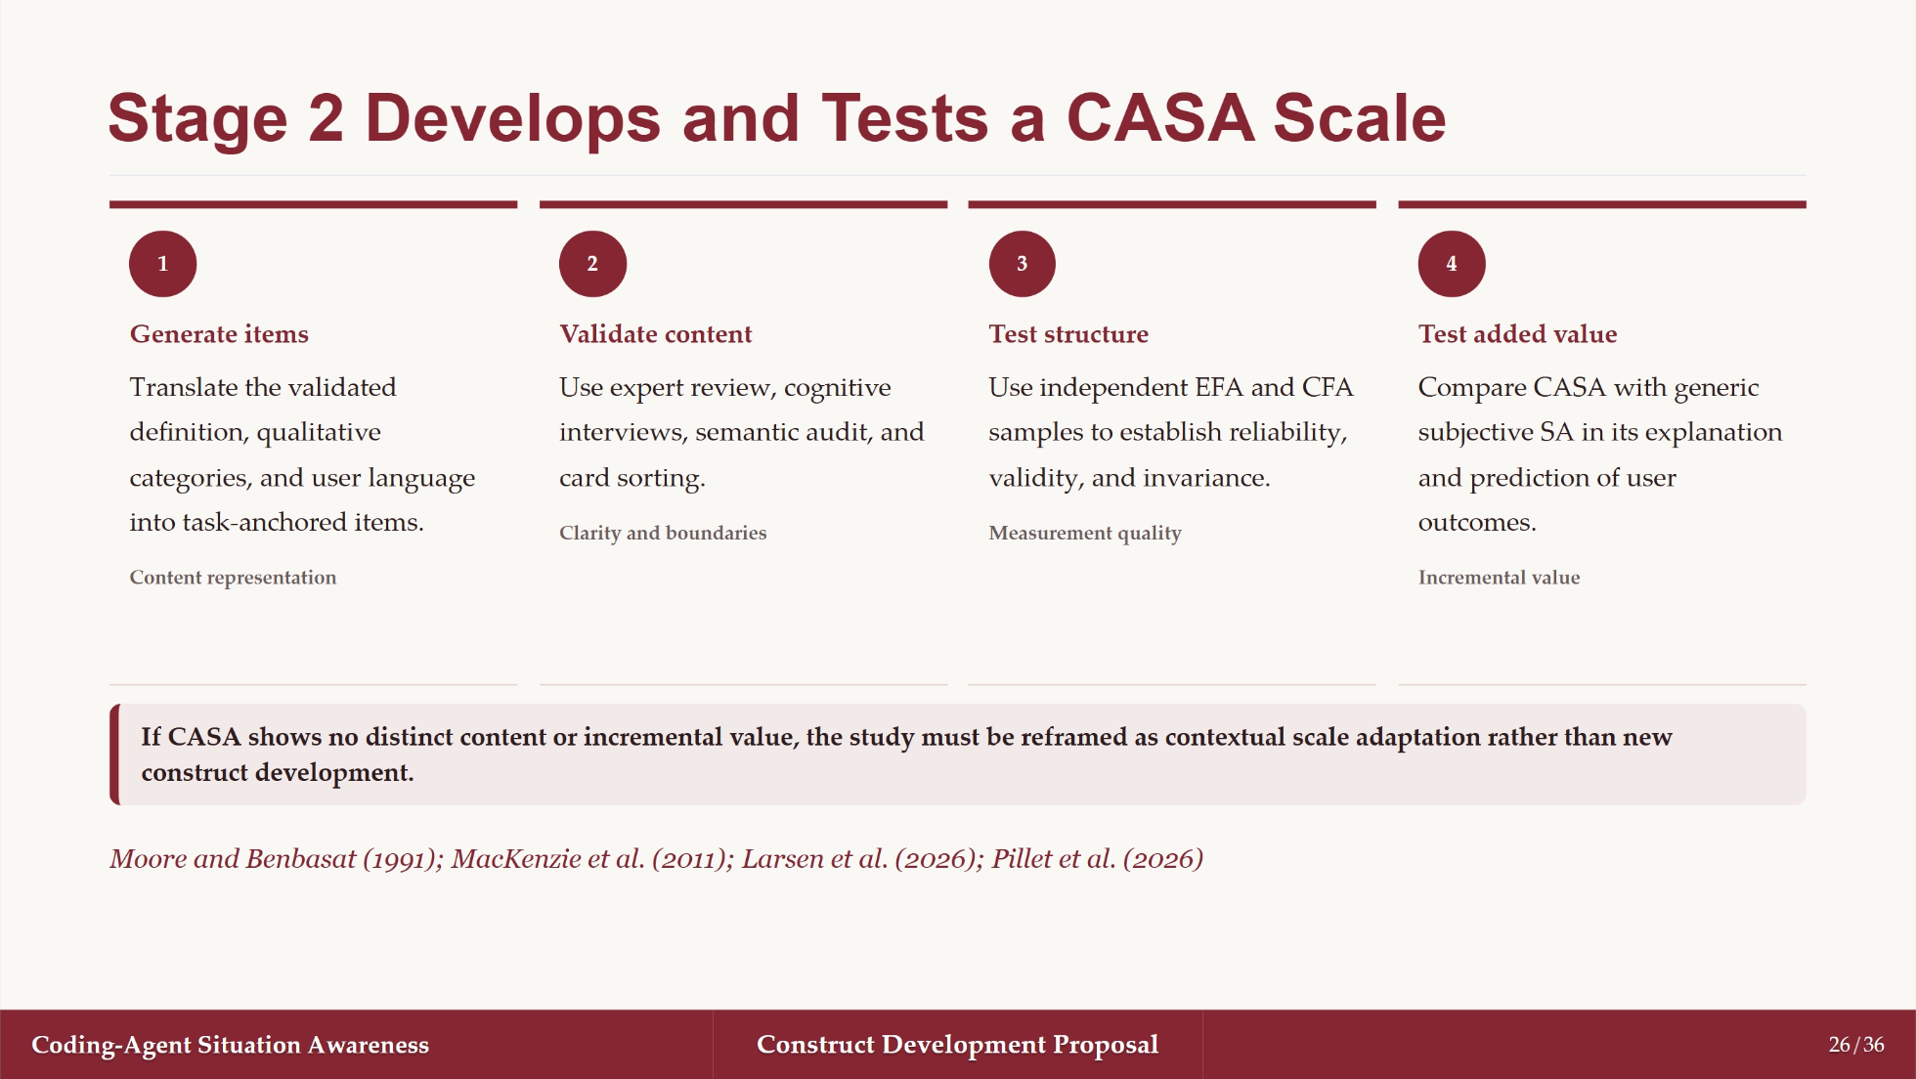
Notes:
Source order: 68, Section 5-6, condensed.

Slide 27
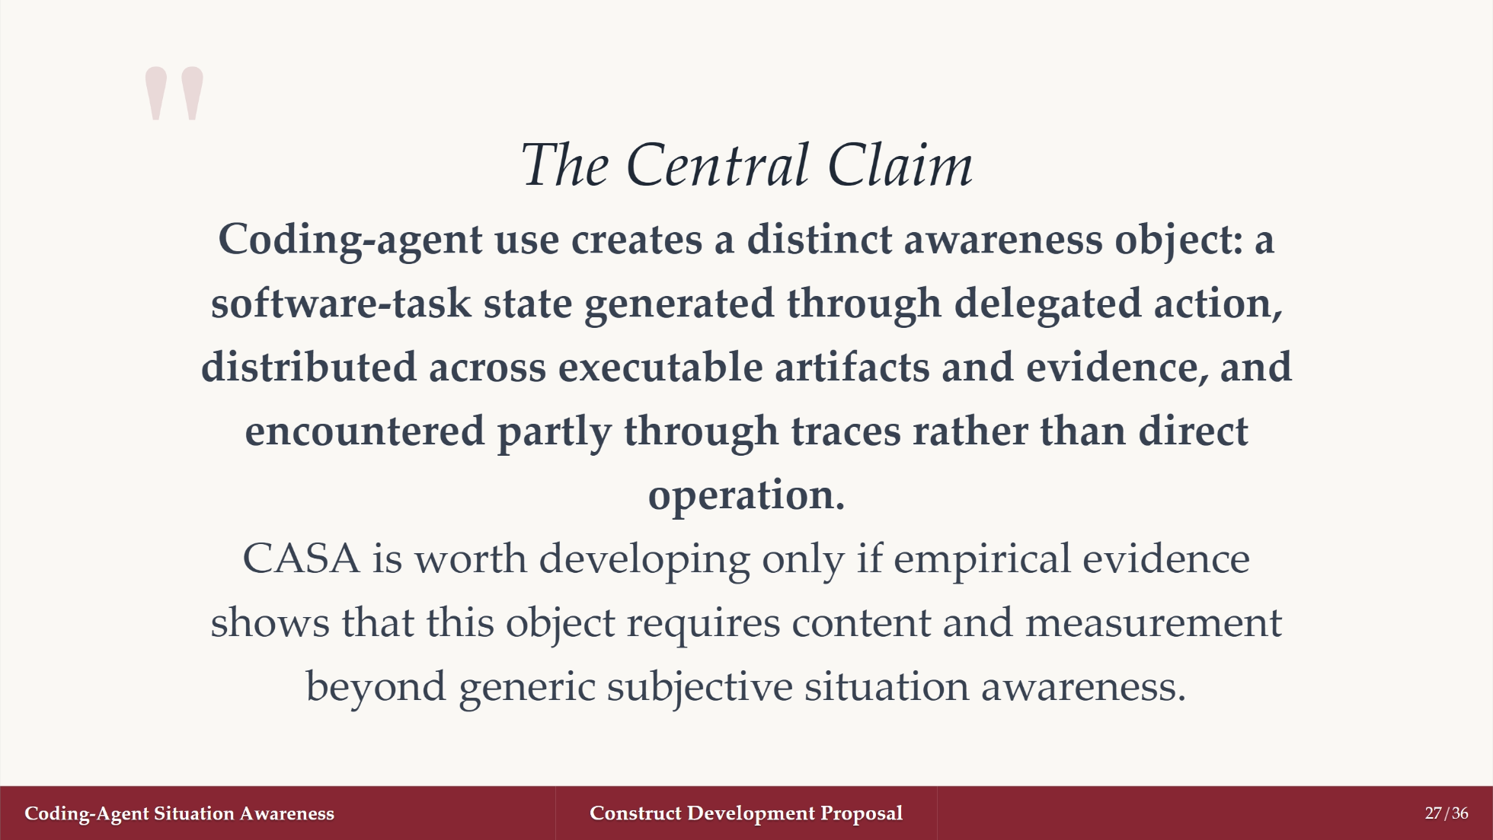
Notes:
Source order: synthesis of 68, Sections 1-6.

Slide 28
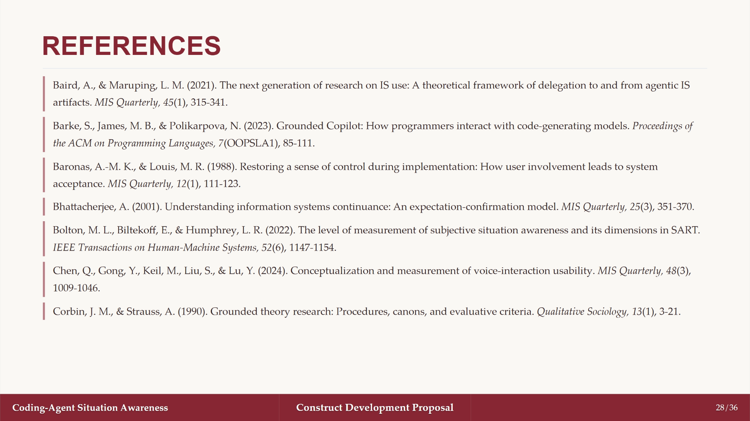

Slide 29


Slide 30
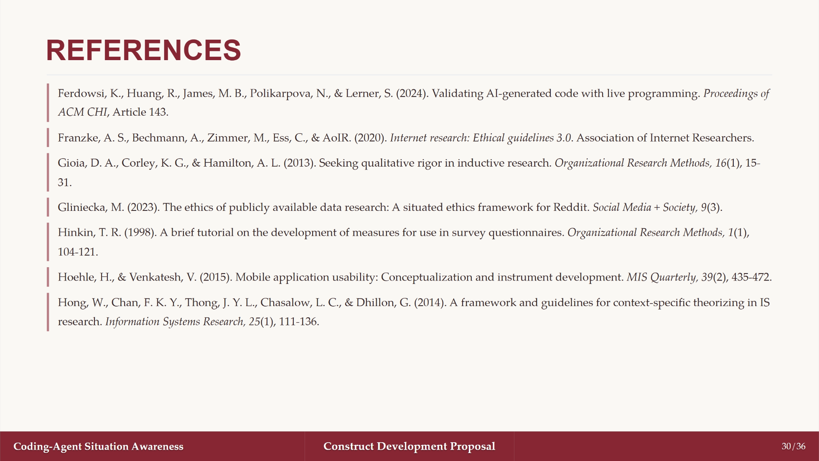

Slide 31
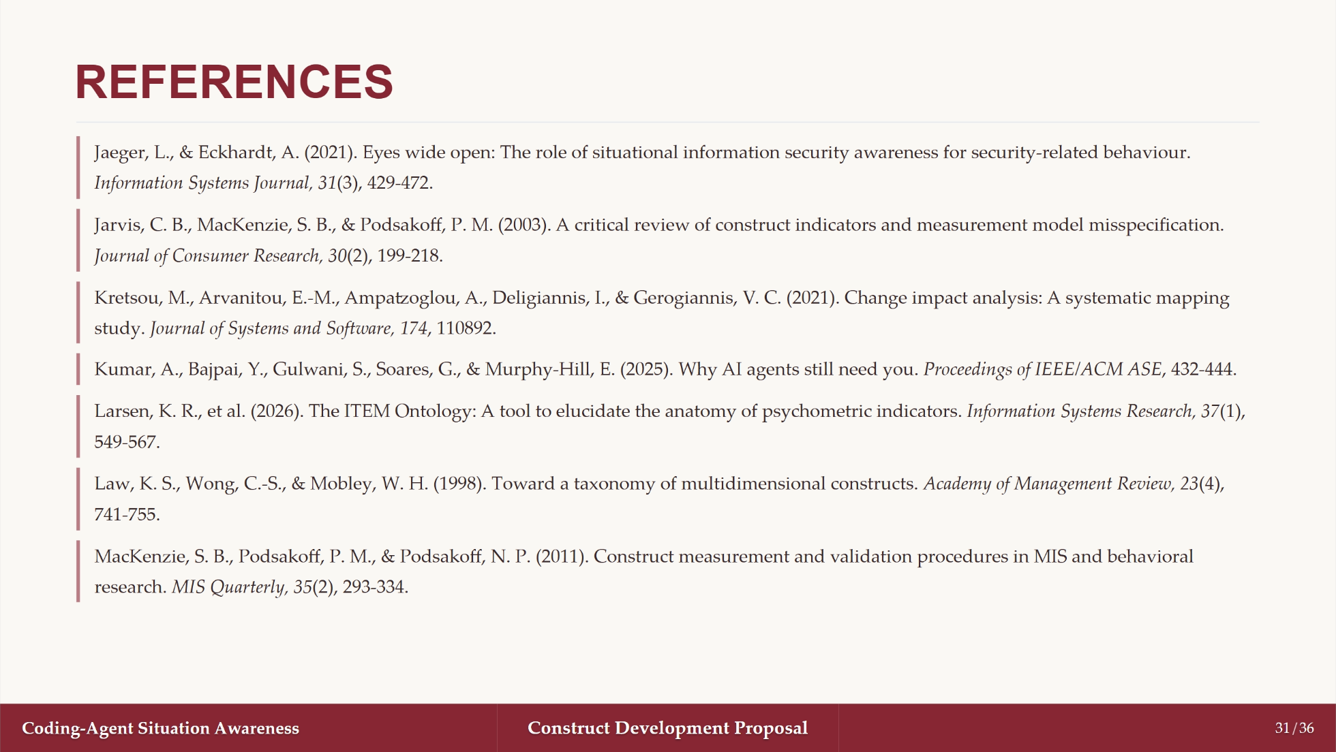

Slide 32
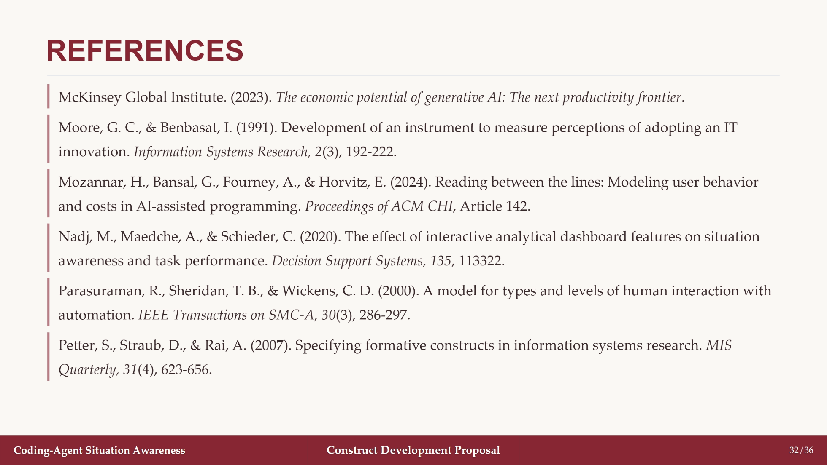

Slide 33


Slide 34


Slide 35
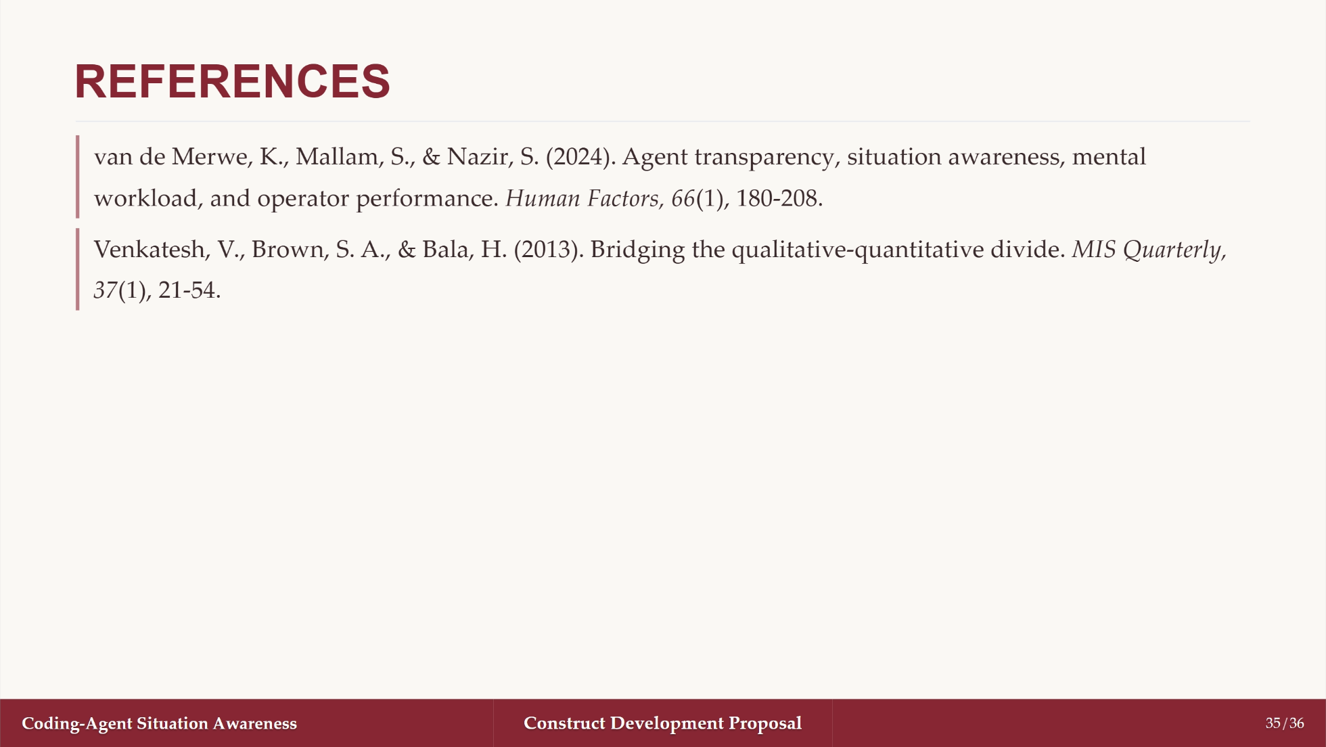

Slide 36
